Slide 1


Slide 2

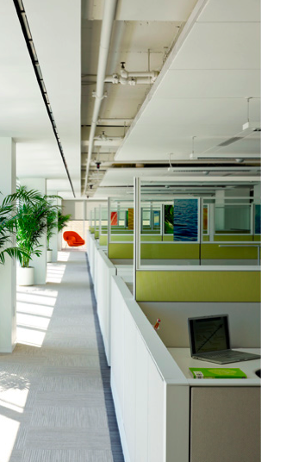
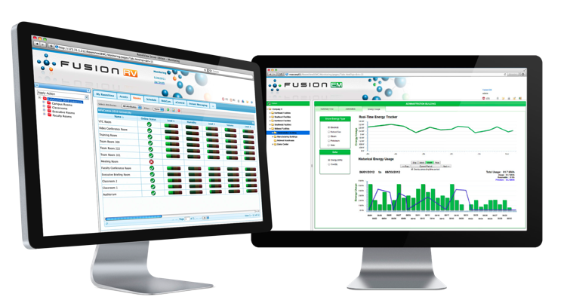
Crestron Fusion™
Enterprise Management Platform
  Integrates systems that typically operate in silos,
  so they work together as a single system
  Adds a layer of intelligence to turn an integrated building into a “smart” building

Slide 3
Crestron Fusion Enterprise
Management Platform: One World View
  Complete visibility to the global enterprise
  Monitor, manage, and control every device in every room, in every building, around the campus, or around the world connected to a Crestron control system

Slide 4
Crestron Fusion Enterprise
Management Platform
  Usage reports supply intelligence needed to make informed decisions about purchasing, staffing, scheduling, resource allocation,
  and workspace design
  Gain insights into how systems are performing, who’s using them, when, where, and how often
  Delivers building technology automation capabilities that save energy and improve productivity by intelligently integrating with building occupants

Slide 5
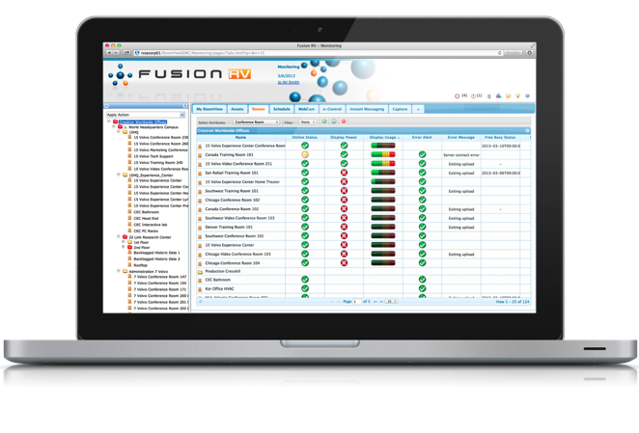
The AV and technology management component of Crestron Fusion

Slide 6

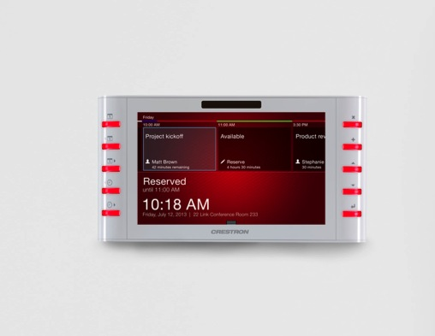
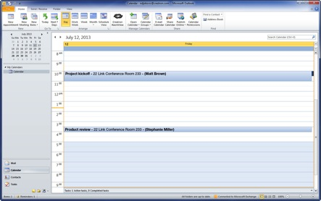




Crestron Fusion RV: Room Scheduling
  Building occupants can book rooms based on location, capacity, and assets
  Network room scheduling from Microsoft® Exchange, IBM® Notes®, R25®, Google Calendar™, the RoomView® add-in for Outlook®, and from touch screens wall-mounted outside each room

Slide 7
Crestron Fusion RV: Room Scheduling
  Intelligent management of resources for increased productivity and efficiency
  Rooms can automatically be made available when no one shows up for scheduled meeting
  Ensures optimal resource allocation

Slide 8
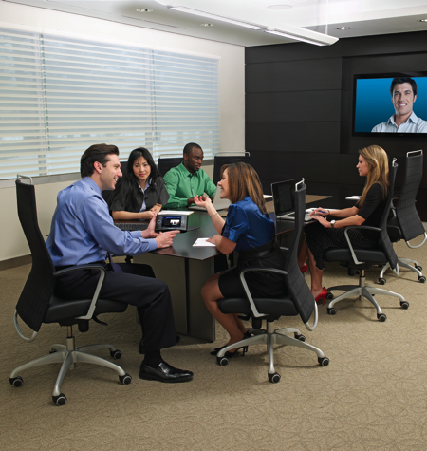
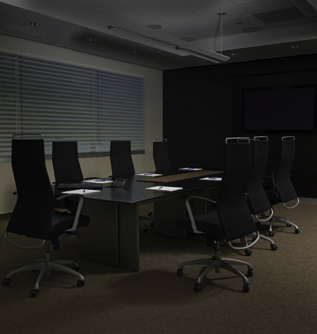
Crestron Fusion RV: Control and Automation
  Preset and automate events, such as end-of-day shutdown, with minimal effort or overhead
  Anticipate issues before they arise and schedule routine maintenance at convenient times
  Monitor room occupancy to automatically turn AV devices “on” and “off” throughout the day, saving energy, and preserving life of equipment

Slide 9
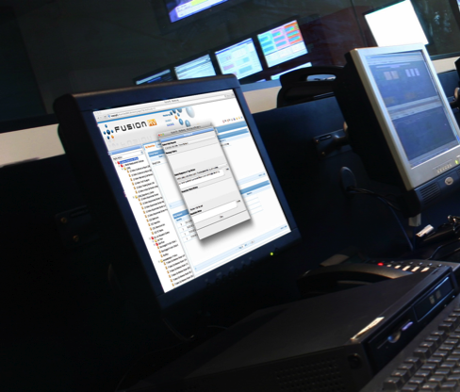
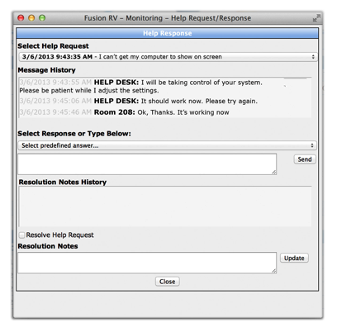
Crestron Fusion RV: Remote Help Desk
  Provide real-time remote assistance and chat with
  room occupants
  Gain visibility into any room from the Web cam tab
  Take control of AV devices to provide optimal technical support in all rooms throughout a campus or global enterprise, even with limited staff – practically
  eliminating downtime

Slide 10
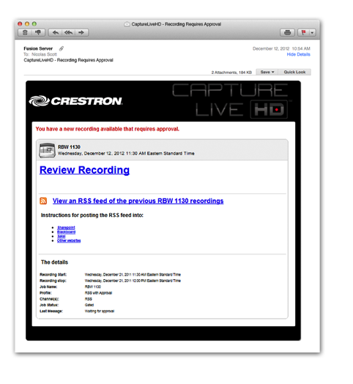
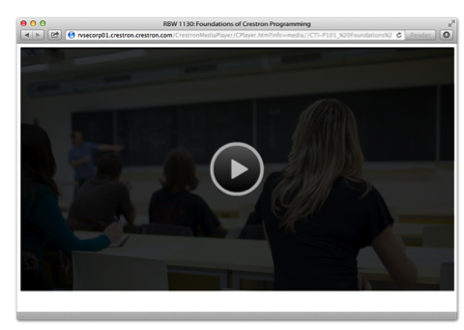
Crestron Fusion RV: Capture
  Workflow engine for Crestron CaptureLiveHD™ - provides seamless automated solution for full-motion HD recording and online distribution of classes, meetings, and presentations

Slide 11
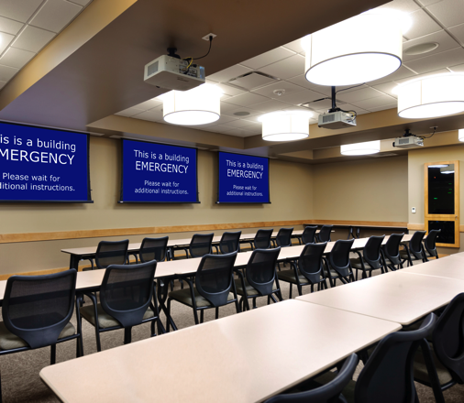
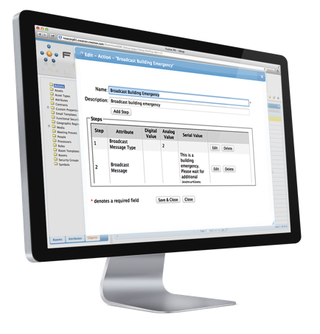
Crestron Fusion RV: Broadcast Messaging
  Provides platform to increase emergency preparedness
  Create and store custom, room-by-room instructions, and safety protocols before critical situations arise
  In an emergency, broadcast messages will automatically override presentation content on Crestron Connected™ displays and Crestron scheduling touch screens

Slide 12
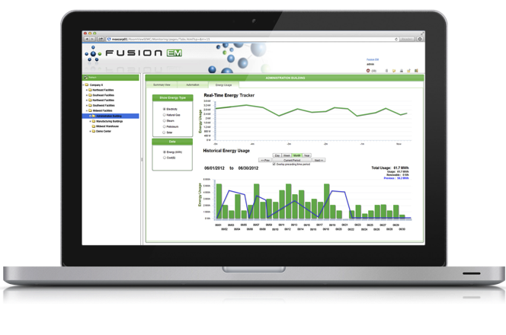
  Complete, enterprise-wide energy management software solution for any size organization
  Enables you to monitor, measure, manage, and control lighting, HVAC systems, and energy usage in every room and area
  Enables you to easily analyze energy consumption and manage your facility

Slide 13

Crestron Fusion EM: Monitor renewable and
sustainable energy resources
  Empowers you to make informed energy decisions
  Track all energy usage and sources using charts and graphs that show real-time and historical consumption
  Can qualify for sustainability credits

Slide 14
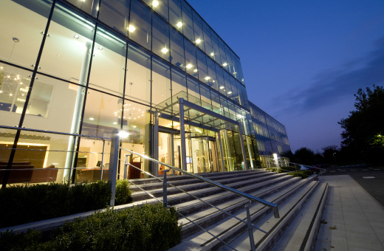
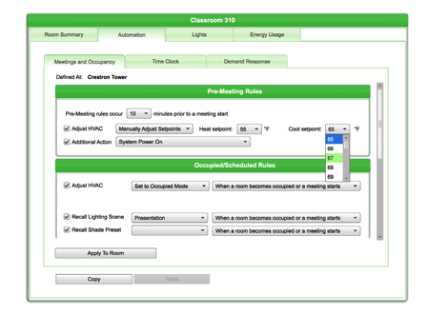
Crestron Fusion EM: Automation
  Reduces energy consumption by automatically turning off lights and reducing HVAC use in unoccupied spaces
  Prepares rooms for meetings so they’re comfortable and ready for business
  If meetings are cancelled or occupancy is undetected, rooms return to vacant state settings

Slide 15

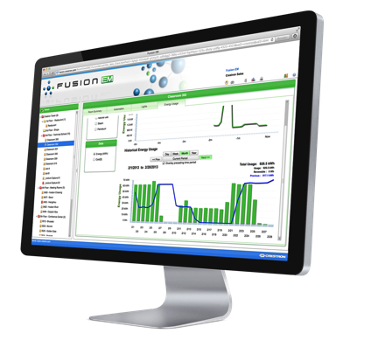
Crestron Fusion EM: Manage
  Track carbon footprint and analyze lighting loads
  View bar graphs showing real-time and historical energy consumption
  Data collection and reporting enable intelligent,
  data-driven planning and forecasting decisions

Slide 16

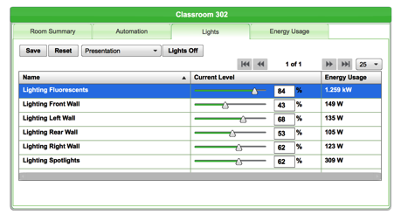
Crestron Fusion EM: Control
  Anticipate events and tailor rooms based on patterns of usage
  Easily change and schedule temperature set points, lighting levels, and demand response settings
  Quickly and easily pinpoint specific sources of waste in real-time and take immediate action
  Centrally-manage building time clock event scheduler

Slide 17

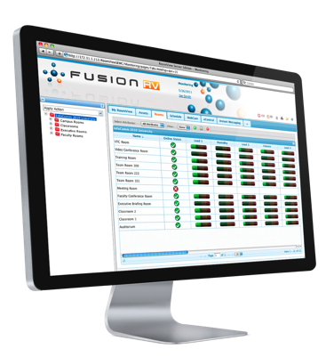
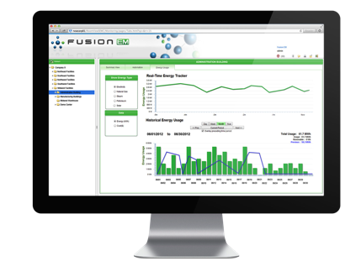
  Integrates with popular management platforms
  Customize settings
  Receive instant alerts
  Track and report usage
  Maximize productivity, efficiency, and cost savings

Slide 18


Crestron Fusion Enterprise
Management Platform: Alerts
  Receive instant alert notifications on any Web-enabled computer, mobile device, or touch screen when issues arise
  Resolve issues before anyone even notices
  Increase efficiency of routine maintenance tasks and prevent equipment failure during usage

Slide 19
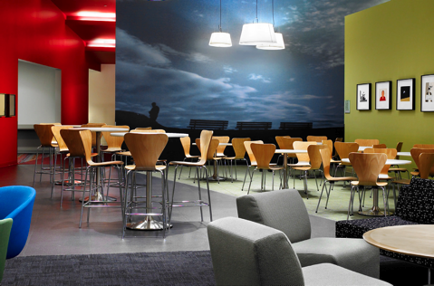
Crestron Fusion Enterprise Management Platform: Adaptive and Event Scheduling
  Automatically shut down displays at end of day, turn lights on and off, and lower shades based on natural light levels
  Track room usage to identify sources of energy waste
  Develop a sustainable energy management plan to increase efficiency and lower costs

Slide 20

Crestron Fusion Enterprise Management Platform: Adaptive and Event Scheduling
Provides real-time data to respond to changing conditions
Use Crestron Fusion reports to more accurately predict usage patterns
Implement customized, automatic environmental settings based on variables such as date/time, season, occupants, and room
Integrated with Micros® OPERA, hotel rooms can be pre-set to personal preferences when guests check in and then revert to “vacant” settings after they check out

Slide 21
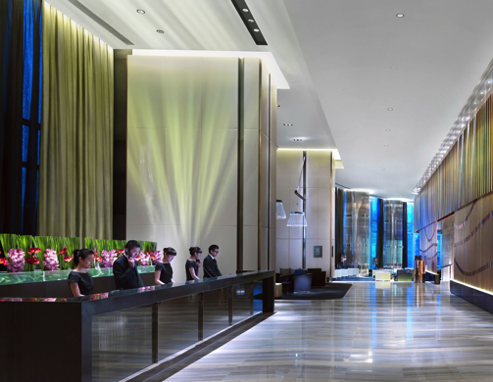
Crestron Fusion Enterprise
Management Platform: API
Support for and integration with popular scheduling and resource management applications and vendors
Adds a layer of intelligence, providing greater visibility and control of the entire enterprise

Slide 22

Crestron Fusion Enterprise Management Platform: Tracking and Reporting
  Maximize room usage
  More effectively plan budgets and forecast staffing needs
  Auto-discover assets upon deployment for improved tracking
  Built-in templates for quick reports
  Quickly add custom reports
  Automatically send any report to a group of recipients on a recurring basis

Slide 23
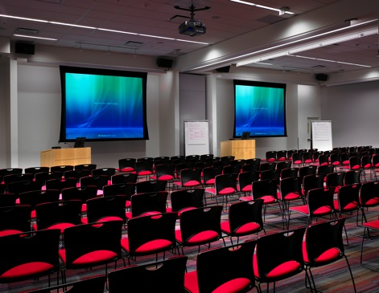
Crestron Fusion Enterprise Management Platform: Flexible pricing
  Connect up to five rooms: FREE
  Unlimited connectivity for enterprise deployment (more than five rooms): $5,000 MSRP
  Unlimited usage - no per seat license fees
  Special pricing available for Enterprise Partners

Slide 24
crestron.com/fusion
All brand names, product names and trademarks are the property of their respective owners. Certain trademarks, registered trademarks, and trade names may be used to refer to either the entities claiming the marks and names or their products. Crestron disclaims any proprietary interest in the marks and names of others. Crestron is not responsible for errors in typography or photography. ©2013 Crestron Electronics, Inc.

