Slide 1
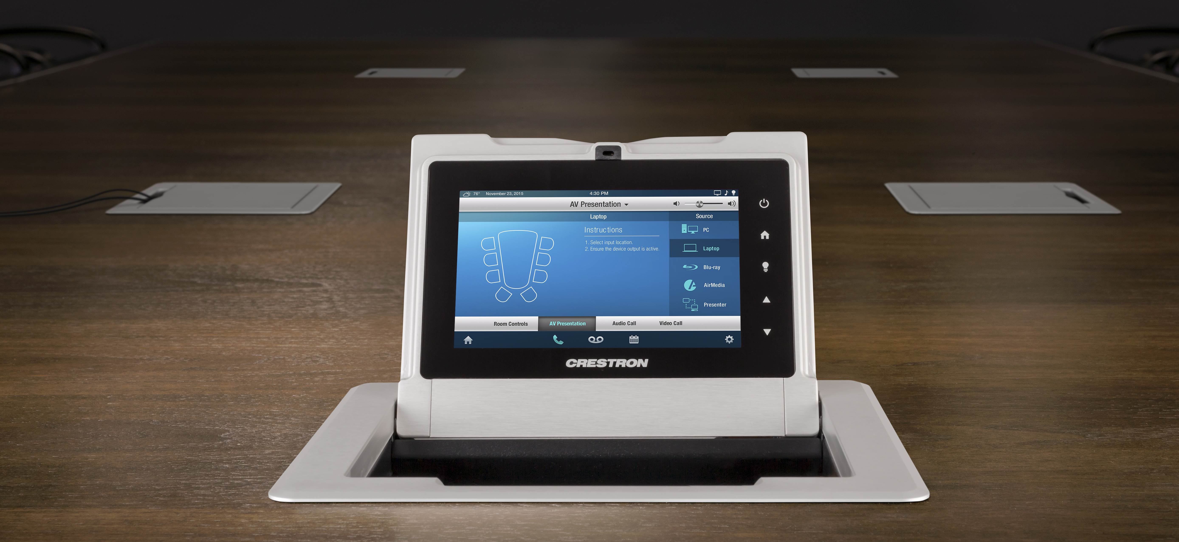
Crestron FlipTops™

Slide 2
Crestron FlipTops
Redefine tabletop cable management and control for the modern conference room
All-new family of configurable FlipTops
Stylish hidden solution for accessing cables, connectors, power outlets, and room control
Easily configurable — the most versatile and complete tabletop conference room solution in its category
Advanced cable management for top-closed operation

Slide 3
Models
FT-600
Basic FlipTop
FT-TS600
FlipTop touch screen
FT-TSC600
NEW! FlipTop touch screen control system

Slide 4
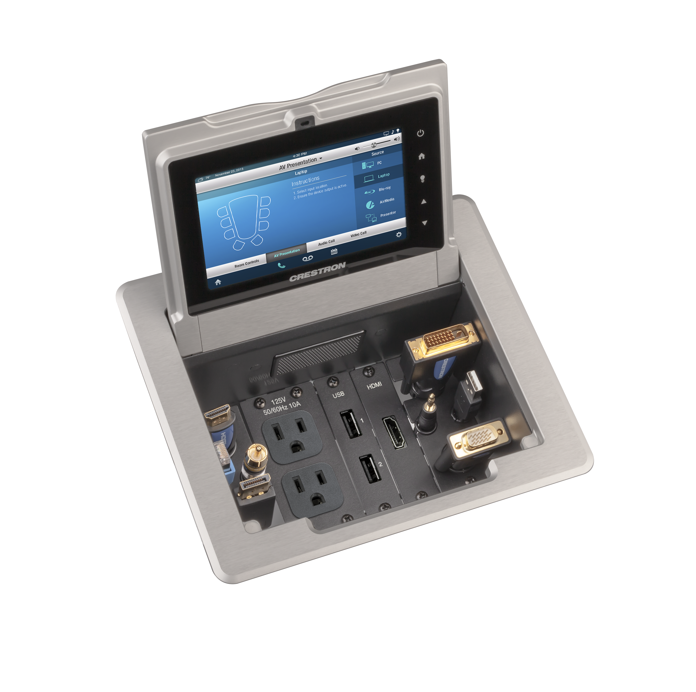
The New FT-TSC600
Built-in 3-Series control processor
Total control for an entire room from built-in 5-inch TSW touch screen
Fully-customizable user interface
Select presentation sources, adjust audio levels, dim the lights, lower shades, and more
No need for separate equipment rack

Slide 5
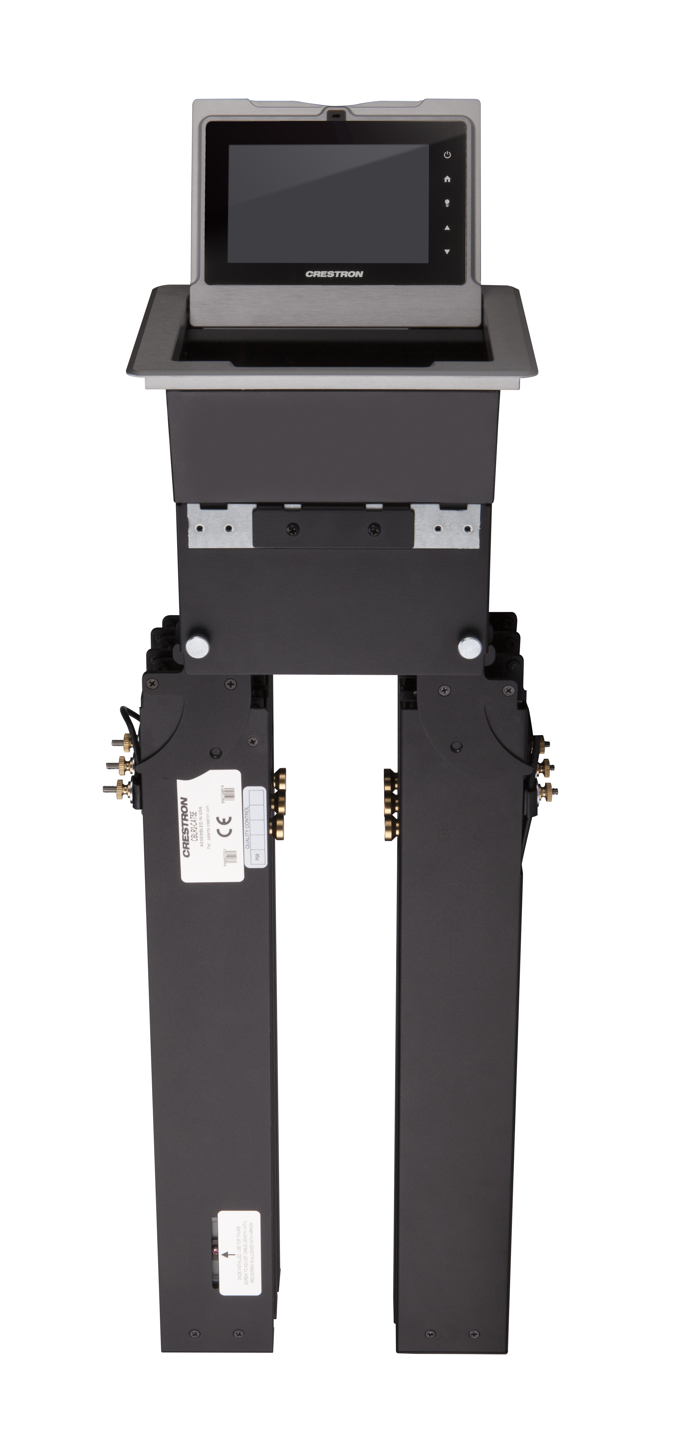
Cable Retractors
A more refined cable management solution
Accommodates up to six CBLR Cable Retractors
Available with HDMI®, VGA, audio, USB, and network cables
Adjustable retraction speeds and ergonomic easy-release lever

Slide 6
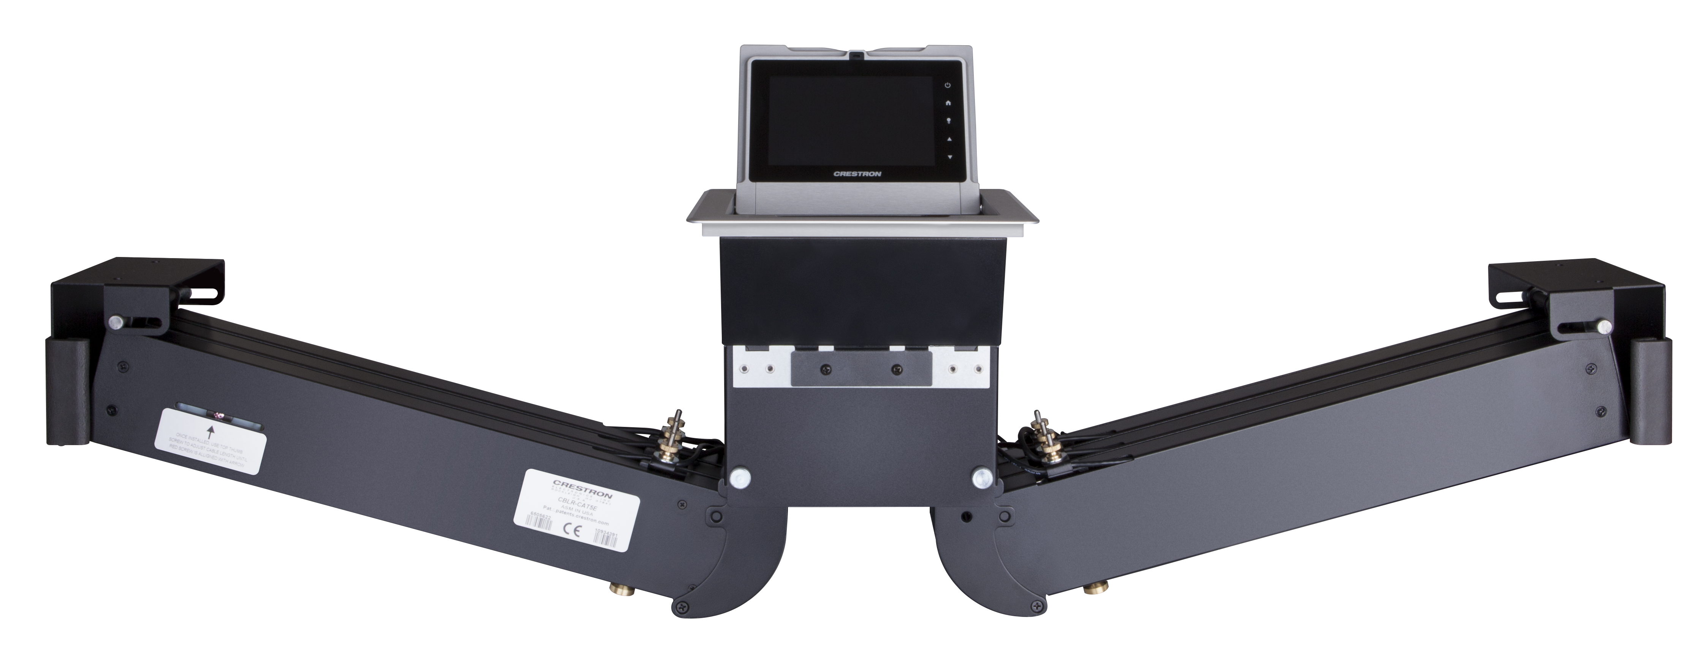
Cable Retractors
A more refined cable management solution
Cables automatically lock in place at the desired length and retract smoothly
Cables are neatly hidden away for the next presenter
Horizontal and vertical mounting options

Slide 7
Your Room, Your Choice
A variety of connector plates and cable pass-thru plates accommodate today’s popular AV and communication connectors
Supports HDMI, Ethernet, DisplayPort, USB, and analog audio and video

Slide 8
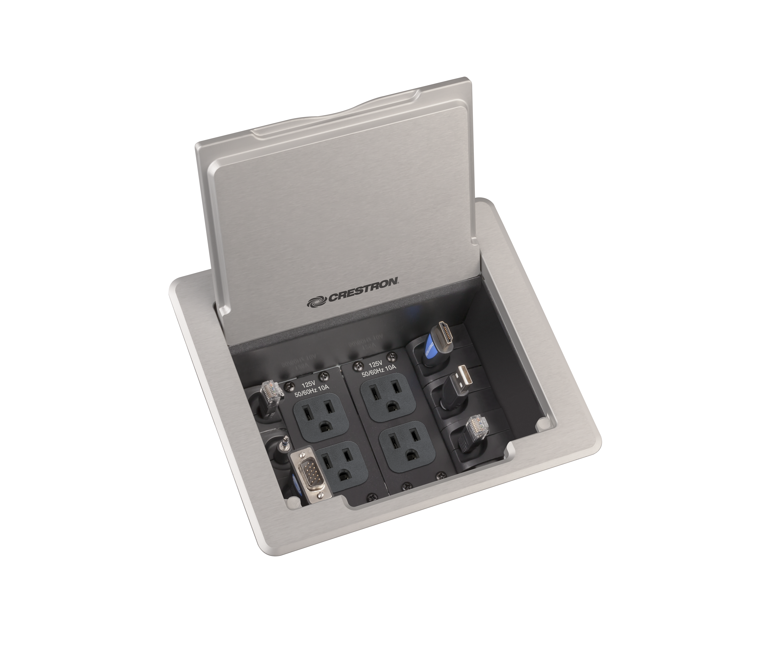
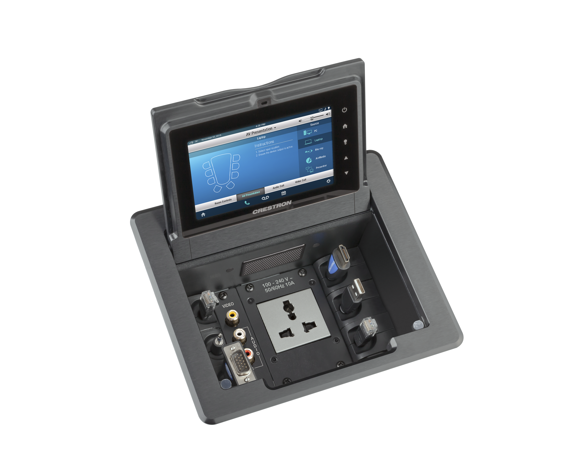
Your Room, Your Choice
Optional AC power outlet plates for charging laptops and personal devices
Also, now available with power outlets for global applications
Easy configuration of your FlipTop in just minutes using our online tool

Slide 9
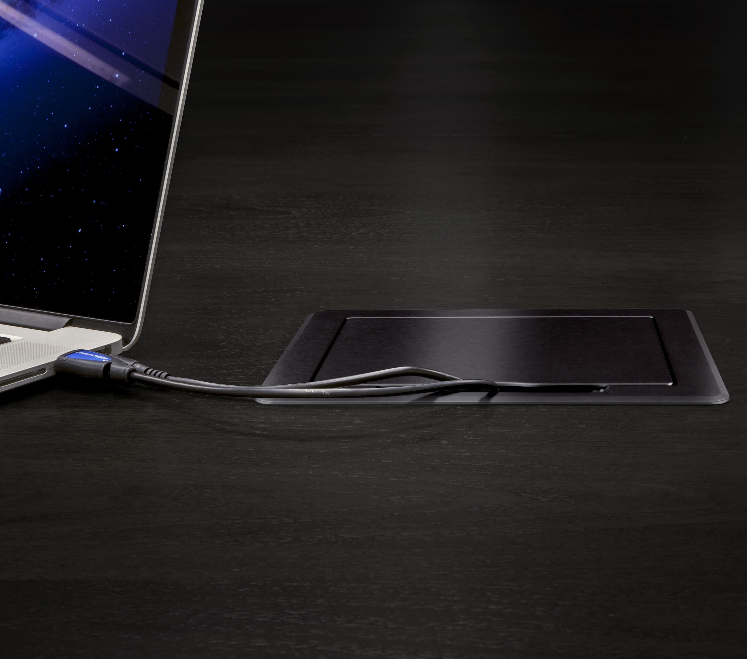
Beautiful Ergonomic Design
Complements the finest conference
tables and podiums
Sleek design, easy installation
Elegant metallic accent, smooth beveled edges, flush appearance
Contoured lid allows cables to remain connected, crimp-free, when FlipTop is closed

Slide 10
Beautiful Ergonomic Design
Complements the finest conference tables and podiums
Cutout templates ensure clean, accurate installations in tables or lecterns up to 1¾" thick
Available in black anodized or brushed aluminum finishes

Slide 11
Accessories
A modular solution you can tailor to meet your specific room requirements
HDMI connector plate
DisplayPort connector plate
Two RJ45 connector plates
Two USB connector plates
Three RCA connector plates
Cable retractor

Slide 12
Accessories
Optional power outlets
U.S.A. (FTA-PWR-102)
Universal (FTA-PWR-261)
UK (FTA-PWR-211)
Europe (FTA-PWR-221)
France (FTA-PWR-231)
Italy (FTA-PWR-241)
Australia/China (FTA-PWR-251)

Slide 13
Crestron FlipTops™
crestron.com/fliptops
All brand names, product names and trademarks are the property of their respective owners. Certain trademarks, registered trademarks, and trade names may be used to refer to either the entities claiming the marks and names or their products. Crestron disclaims any proprietary interest in the marks and names of others. Crestron is not responsible for errors in typography or photography. Specifications are subject to change without notice. © 2014 Crestron Electronics, Inc.

